Slide 1
Course Project Presentation DA312
By- Shivansh Pal 220150022

Slide 2
Facial Emotion Recognition Using CNNs

Slide 3




Dataset - FER2013
Details:
Contains ~35,000 grayscale 48×48 face images
7 Emotion classes: Angry, Disgust, Fear, Happy, Sad, Surprise, Neutral
Pre-split into Training, Public Test, and Private Test sets

Slide 4
Model Architecture
Our CNN follows a hierarchical feature extraction approach, progressing from low-level edges to high-level facial patterns.
Each of the three convolutional blocks consists of a convolution layer with a 3x3 kernel, batch normalization to stabilize gradient flow, a ReLU activation for non-linearity, and a 2x2 max-pooling to downsample feature maps:
Block 1: 32 filters, output size (46,46,32).
Block 2: 64 filters, output size (21,21,64).
Block 3: 128 filters, output size (9,9,128).

Slide 5
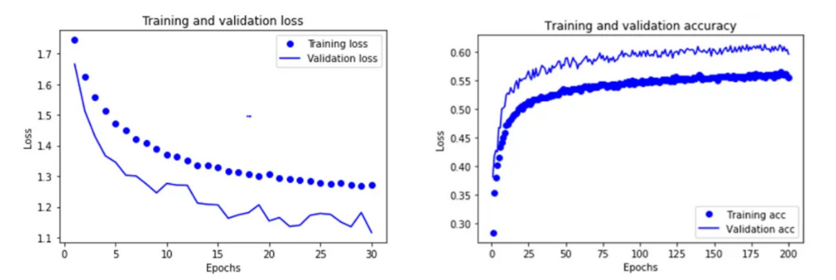
Training
Training was conducted on a GPU-enabled environment, with the following configurations:
• Loss Function: Categorical cross-entropy, suitable for multi-class classification.
• Optimizer: Adam with initial learning rate 1e− 3, chosen for its adaptive learning capabilities.
• Batch Size: 64, balancing convergence stability and training speed.
• Epochs: Up to 50, with early stopping on validation loss (patience = 5 epochs).
• ModelCheckpoint: Save the model weights achieving highest validation accuracy.

Slide 6
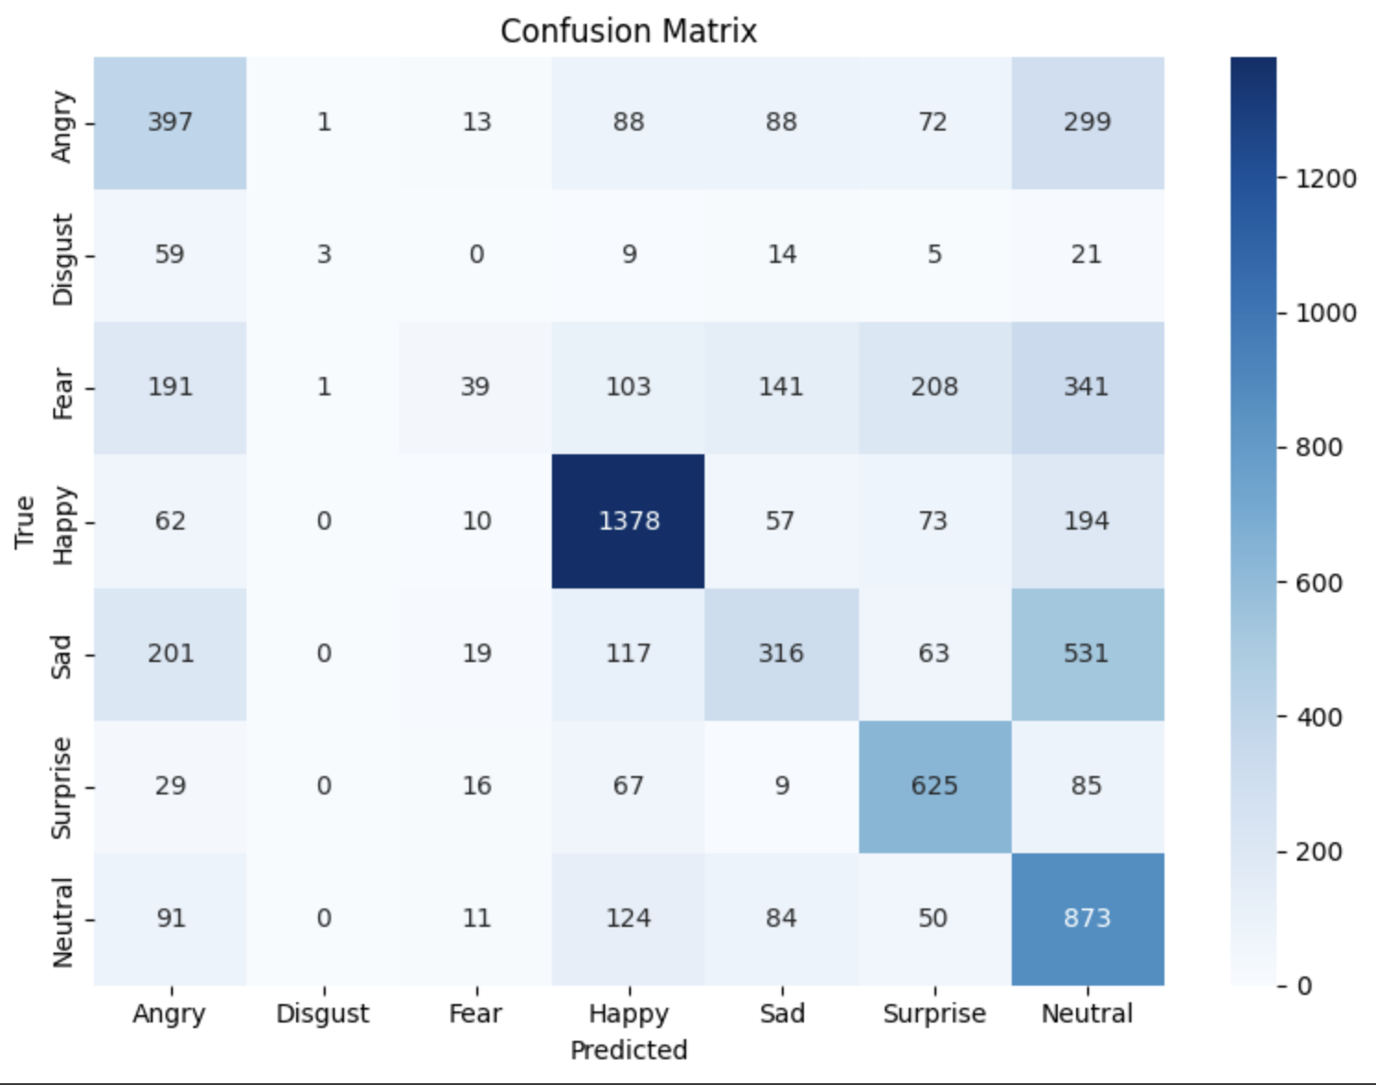
Result & Analysis
After training, the best model achieved the following on the private test set:
Final test results of the model on the FER-2013 dataset.
Test Accuracy 59.84%
Test Loss 1.1123

Slide 7
Classification Report
Precision Recall f1-score
Angry 0.385437 0.414405 0.399396
Disgust 0.600000 0.027027 0.051724
Fear 0.361111 0.038086 0.068905
Happy 0.730647 0.776776 0.753005
Sad 0.445698 0.253408 0.323108
Surprise 0.570255 0.752106 0.648677
Neutral 0.372440 0.708029 0.488119

